Slide 1

Welcome to:
Tuesday’s 6-7pm
Broun Hall Room 235

Slide 2
Introduction
Founded in 2006 by the Auburn University ECE Department
Acts as a “makerspace” that provides a place for students to work collaboratively on projects.
Provides the space, tools, and some resources for these projects.
No prior experience is required.
Great for students of all ages and majors.
Can act as a pathway to get involved in Undergraduate Research.

Slide 3
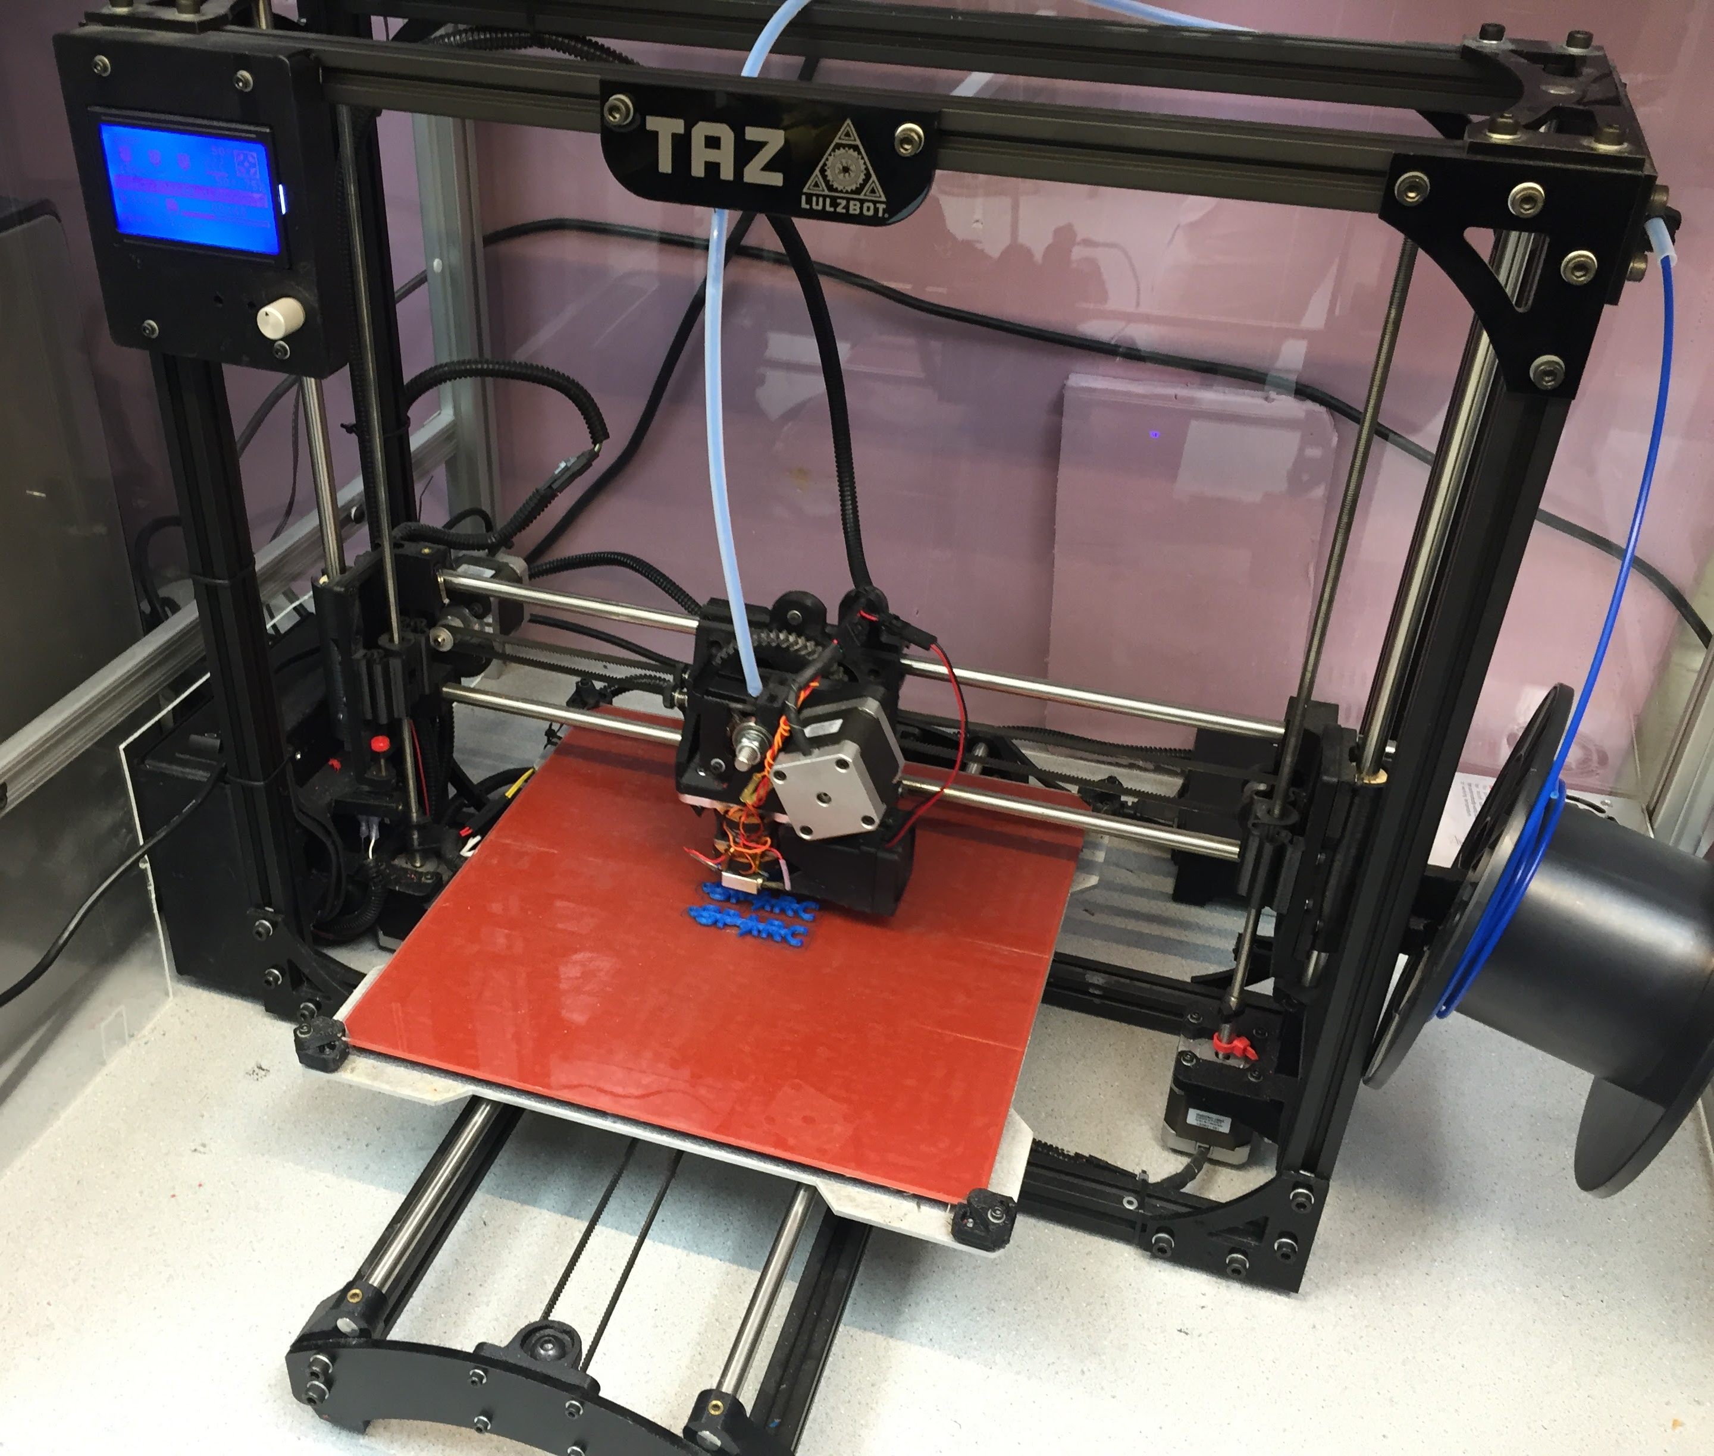
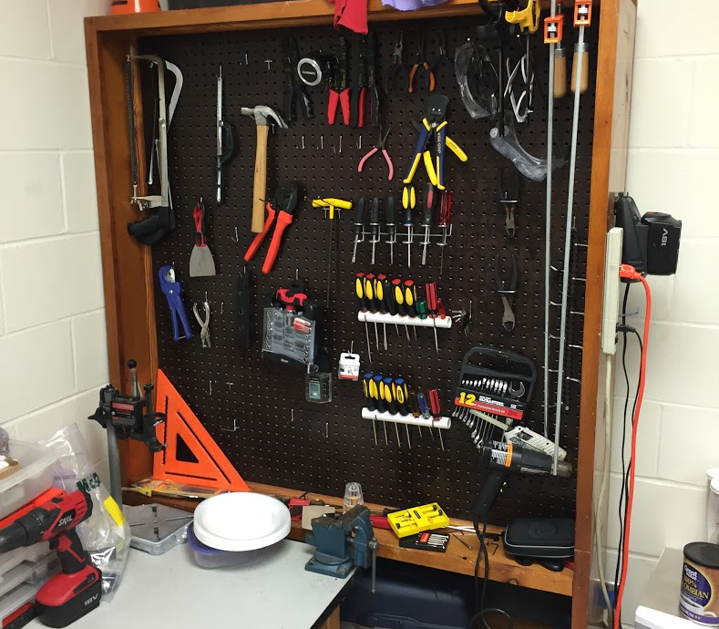
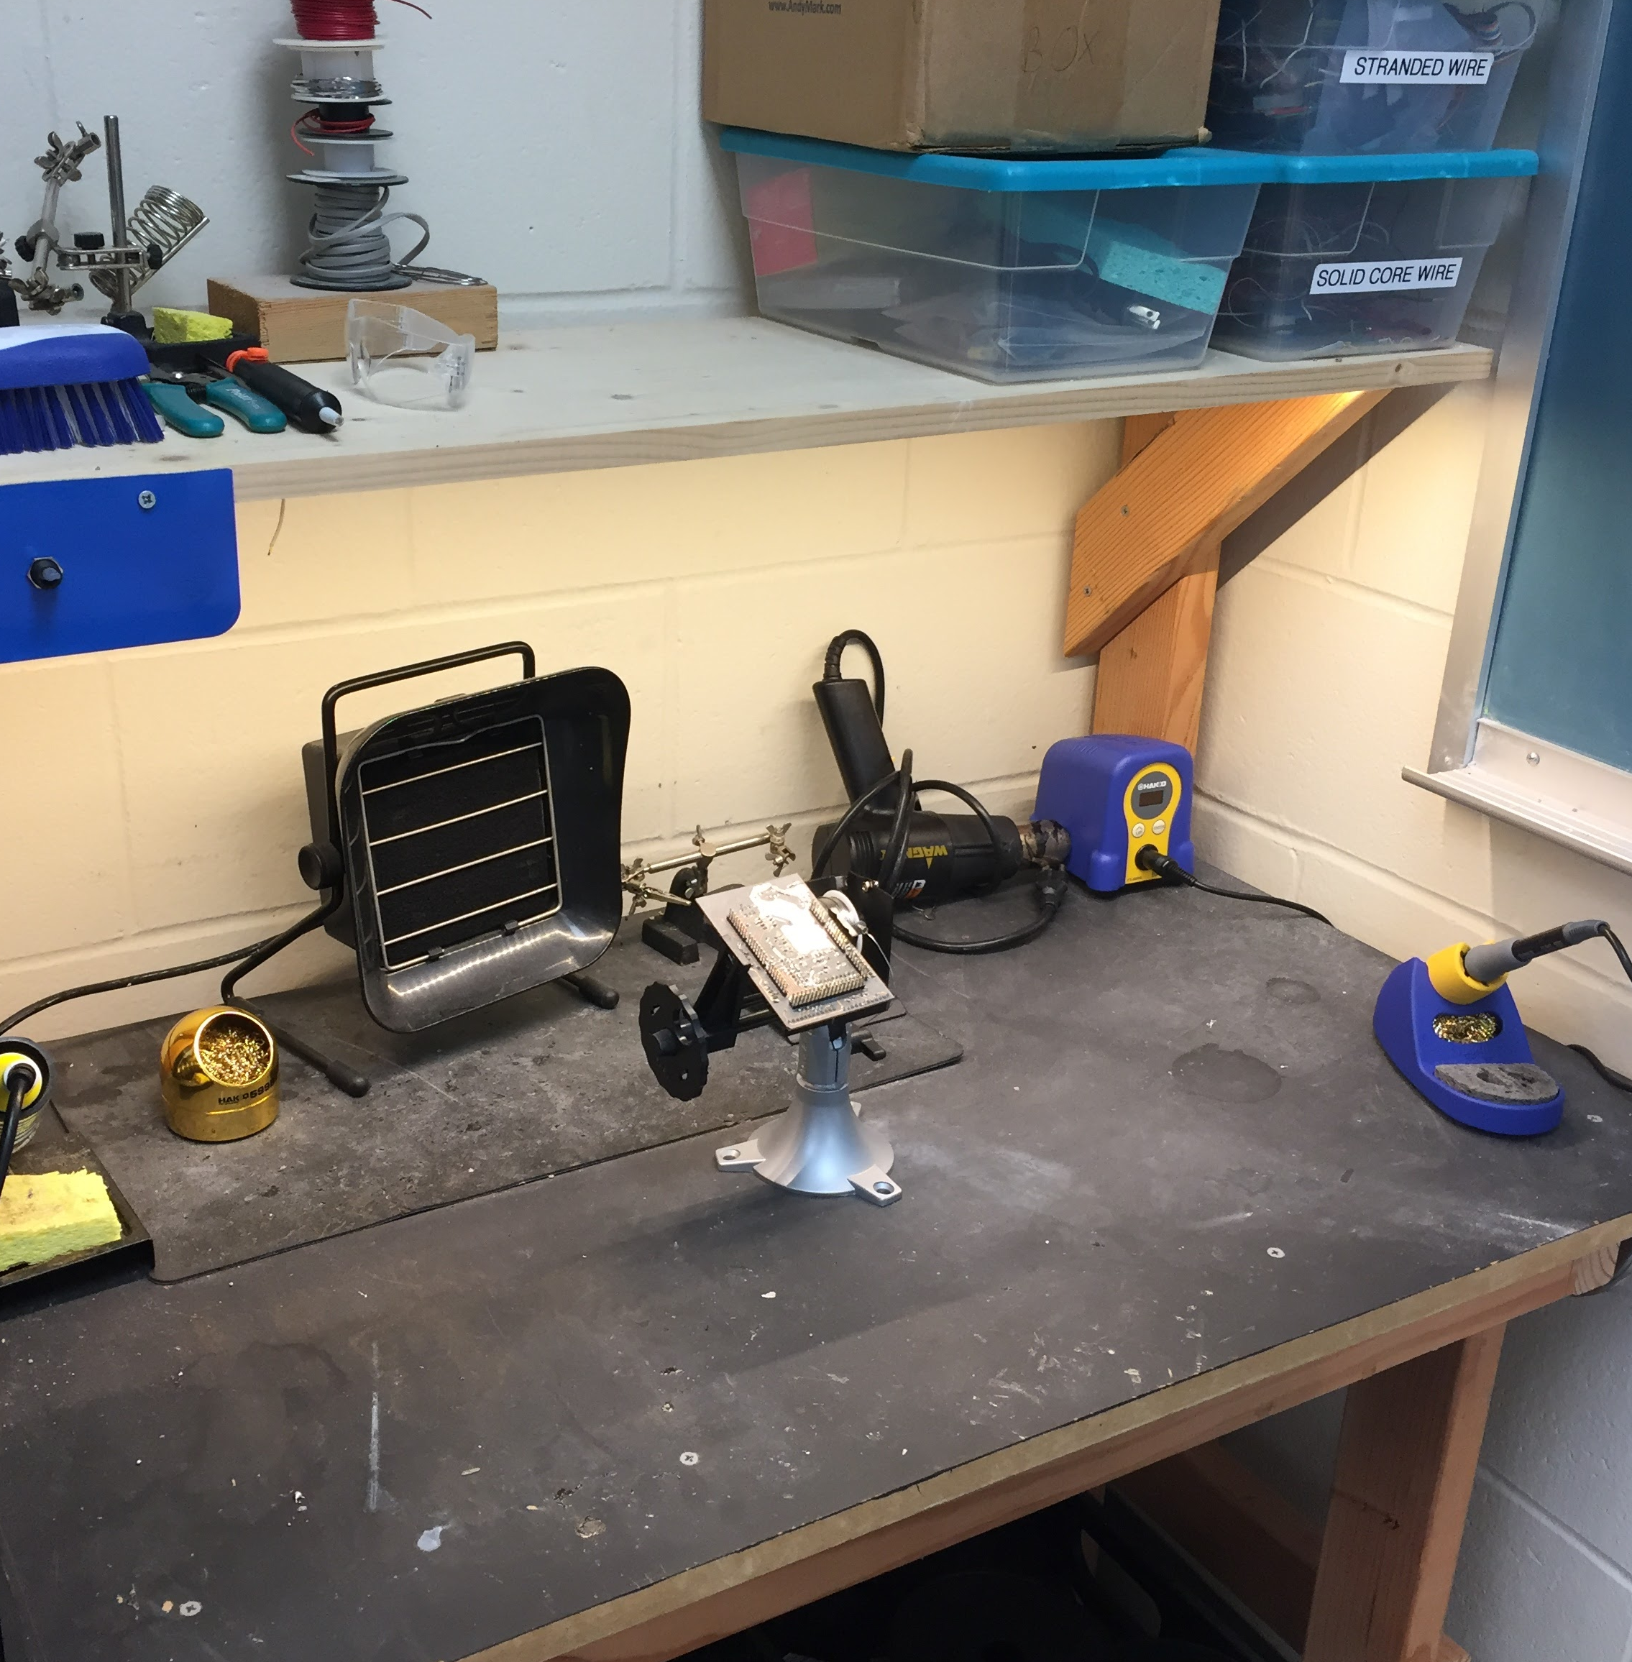
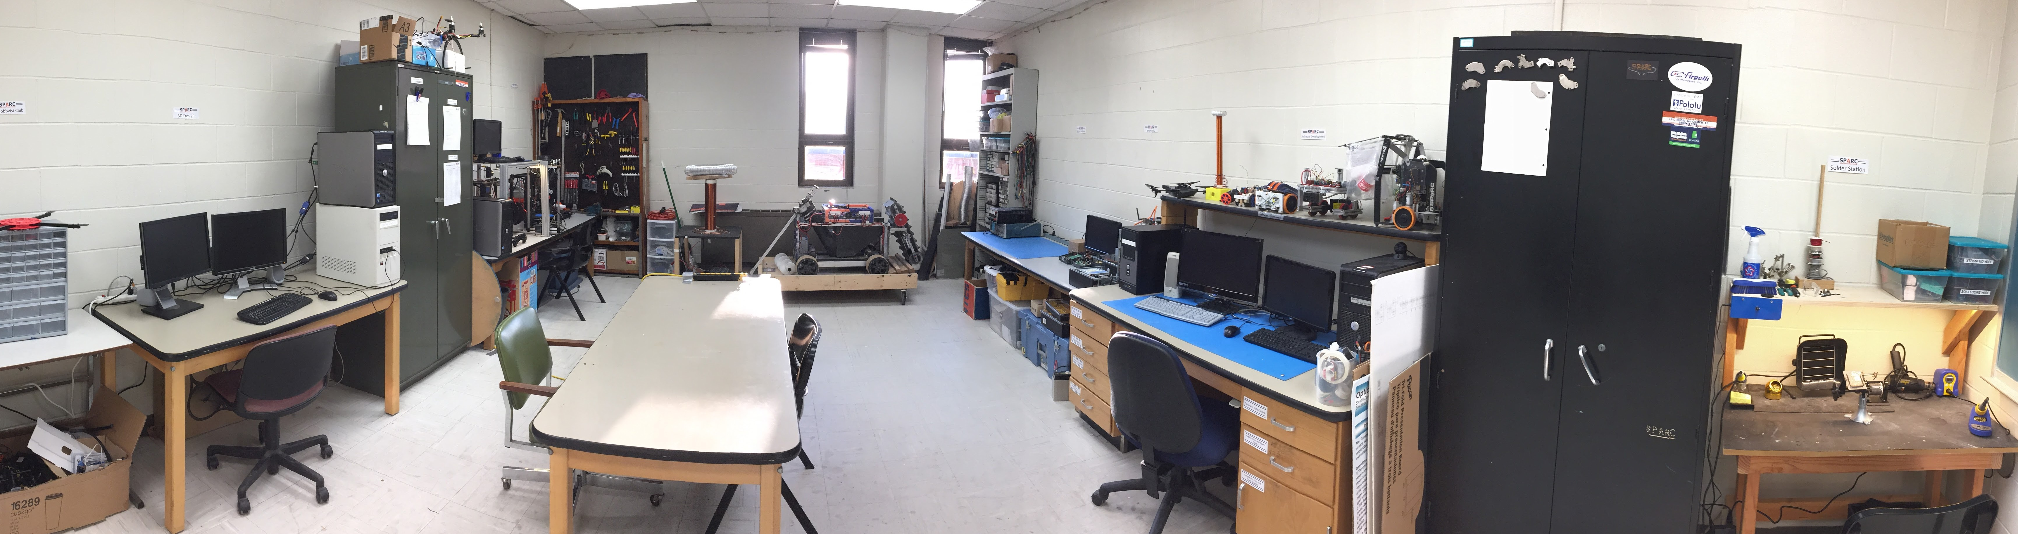
Our Lab
Broun Hall
Room: 367

Slide 4
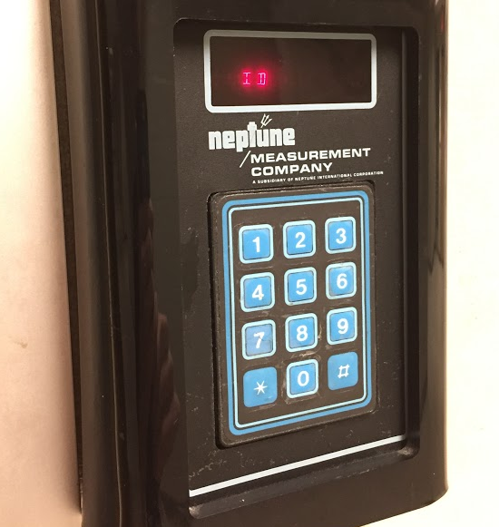
How to become a Member
Log 5 constructive hours in the lab
Write the times on the sheet on the cabinet on the left side of the room.
Contact us at Sparc.Auburn@gmail.com:
Include your Banner ID #
You will be given code access code that will give you 24/7 access to Broun 367 and Broun Hall.

Slide 5
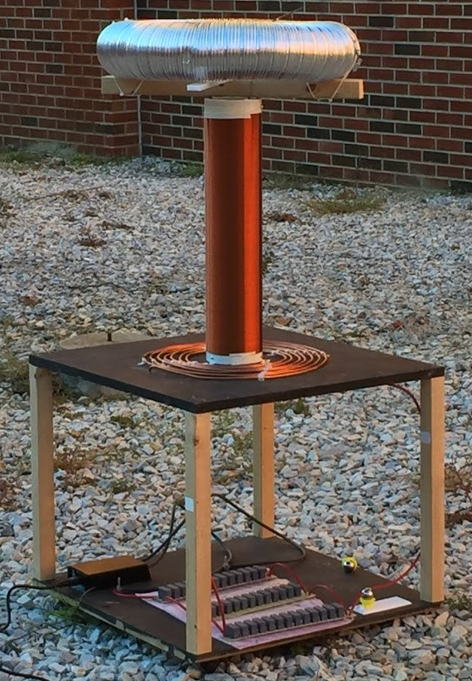
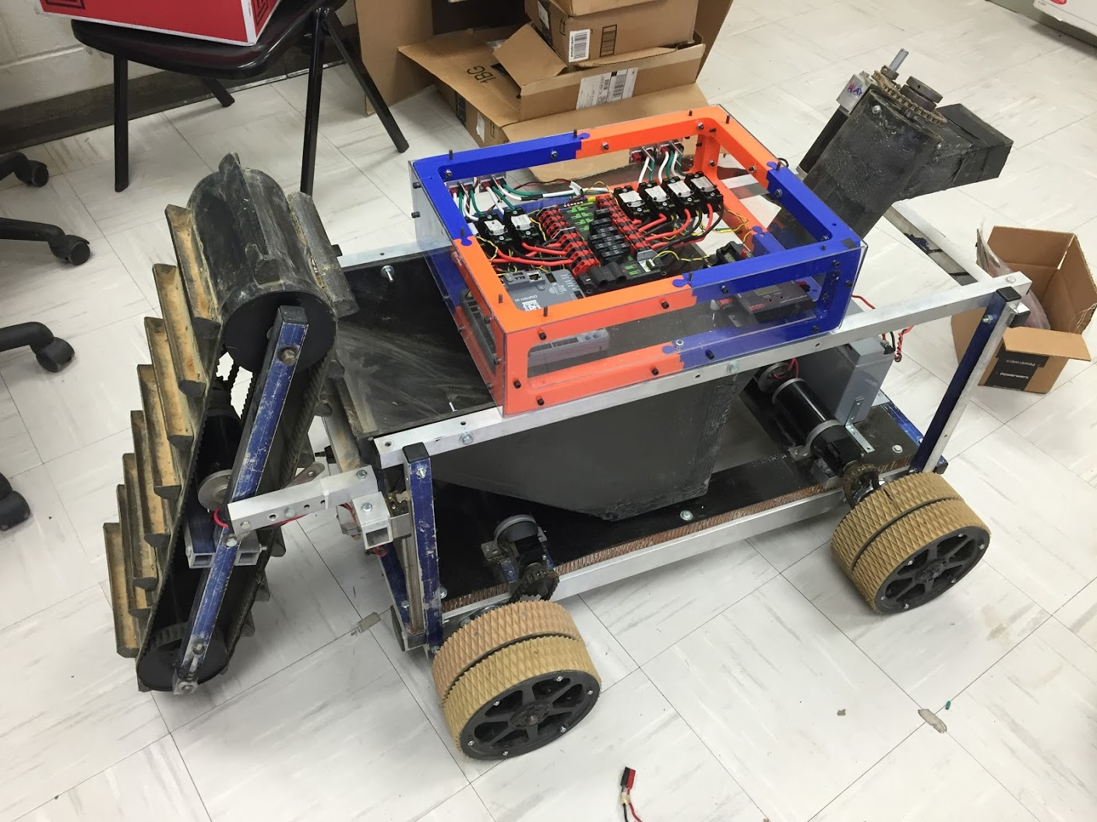
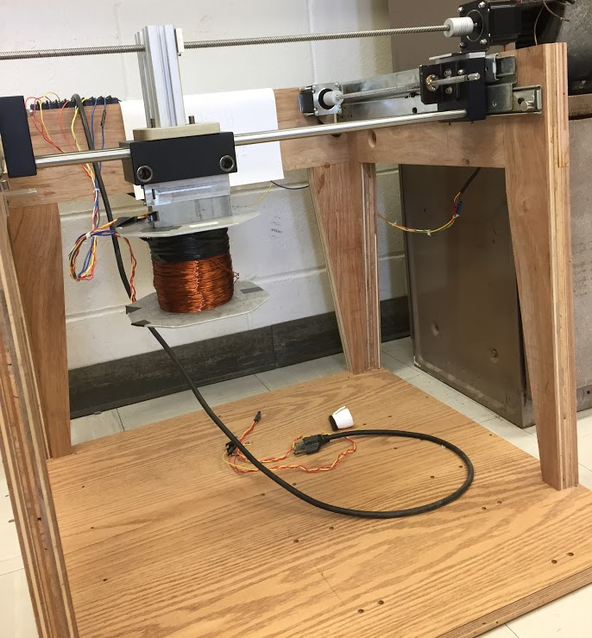
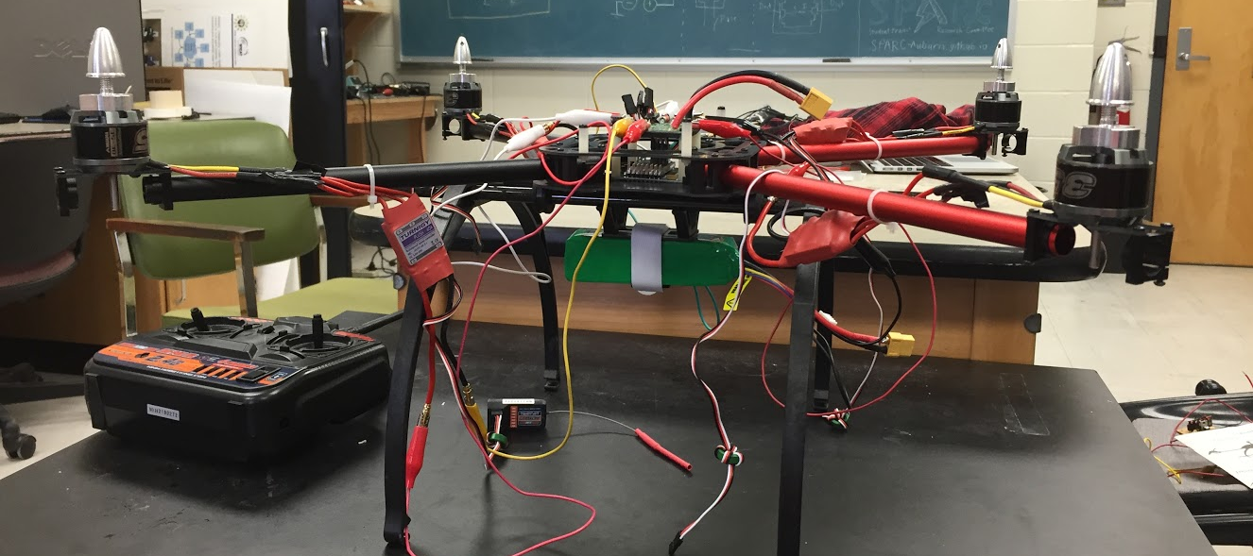
Current Projects and Teams
Robotics and Automation
NASA RMC
Matilda
Automated Lab
Research
Unmanned Aerial Vehicles
RC Hobbyist Club
XT-8F UAV
Outreach and Demonstration
Claw Machine
Tesla Coil

Slide 6
Projects: NASA Robotics Mining Competition
A 3rd Year Robotics team that designs and builds a robot
collects simulated Martian soil in a small arena
dispenses it into a small bin on the other side of the arena.
Can be remotely controlled or for bonus points autonomously controlled
Competition is held at the Kennedy Space Center
Part of Auburn’s SPACE Club and affiliated with SPARC.
Team Lead:
Jeremy Frasher jjf0010@auburn.edu
Meetings:
TBD
2016 NASA RMC Robot

Slide 7
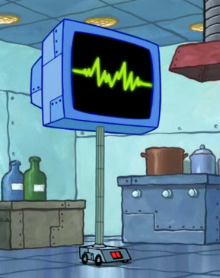

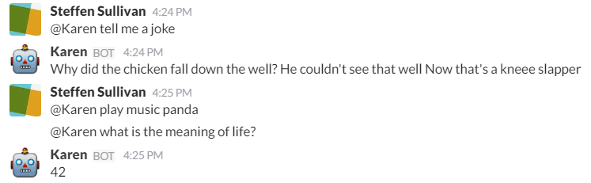
Projects: Automated Lab
Create an automated lab assistant.
Will be voice controlled.
Will allow door to be unlocked temporarily remotely to allow new members access to the lab.
Will consist of both a stationary and mobile system.
Will be embedded on the new group chat system Slack.
Team Lead:
Steffen Sullivan (sbs0034@auburn.edu)
Meetings:
To be determined
Location- SPARC Lab Broun 367
Kinematic
Autonomous
Robot
Enriches
Newcomers

Slide 8
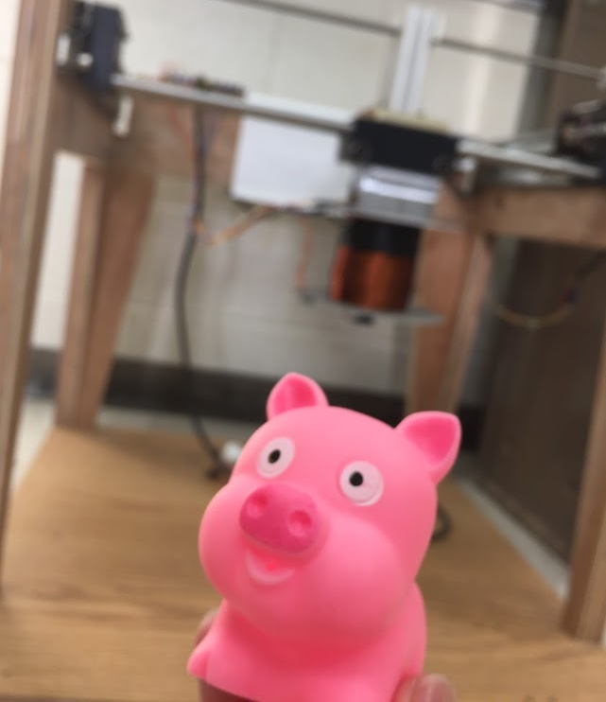
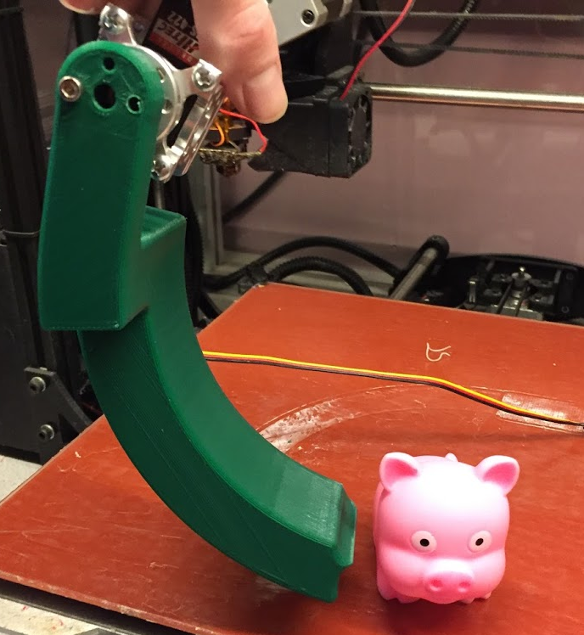
Projects: SCORE Crane Machine
Build a claw machine where “everyone wins”.
Will provide a fun way to distribute promotional items for the Southeastern Center of Robotics Education (SCORE).
Suspend a 3D printed servo controlled claw vertically from the MAGLEV dual axis actuation system.
People will use a joystick to manipulate it and pick objects.
Team Lead:
Shane
Meetings:
TBD

Slide 9
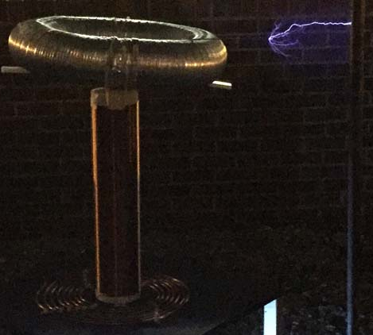
Projects: Tesla Coil
We created a spark gap Tesla Coil.
It generated 400,000 volts of electricity
Goals this year:
Make it operational again
Enhance it using homemade capacitors
Make it musical

Slide 10
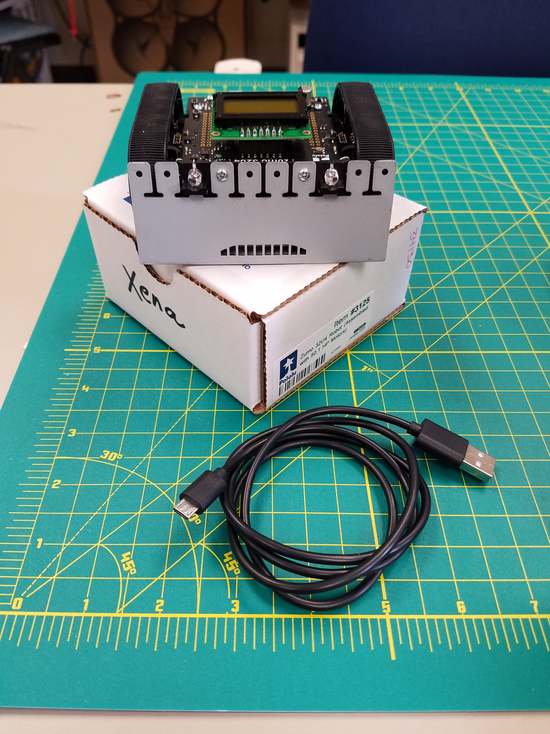
Projects: Zumo Bot
Hope to be a department wide competition.
Runs the Arduino program
Project Lead
Noah Niedzwiecki (nmn0005@auburn.edu)
Meeting Times:
Wednesdasy @ 6pm

Slide 11
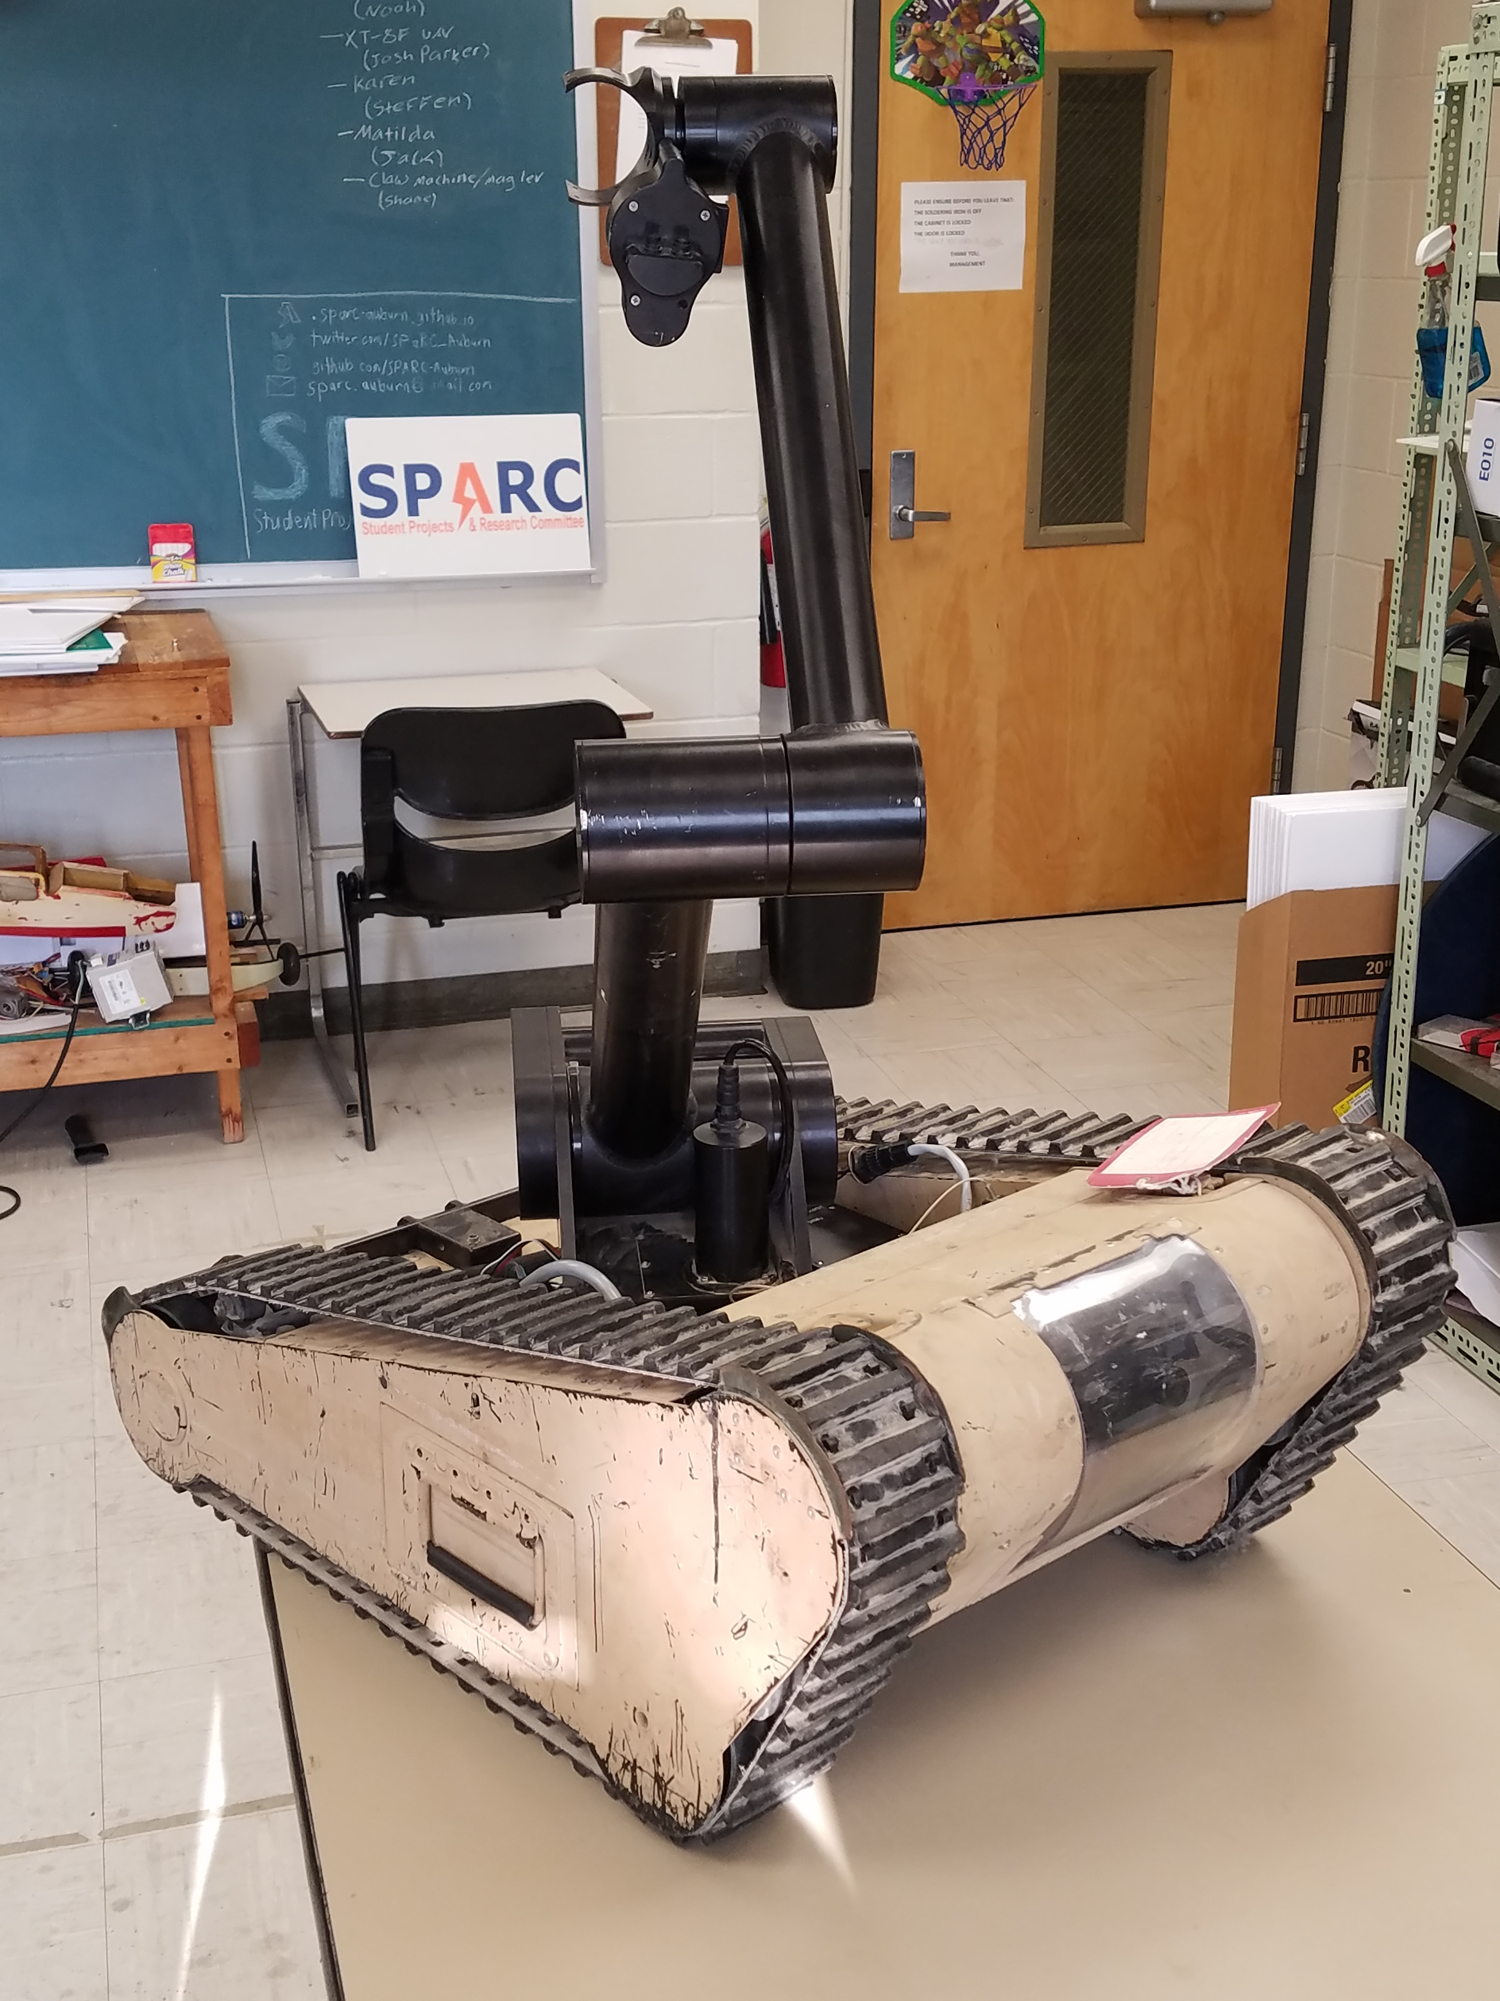
Projects: Matilda
A bomb disposal robot from Dr. Roppel that is currently in disrepair.
Project Lead
Jack Thomas (jet0024@auburn.edu)
Meeting Times:
Thursdays @ ???

Slide 12
Useful Links
Website
http://sparc-auburn.github.io/
Github
https://github.com/SPARC-Auburn
SPARC Documents
https://github.com/SPARC-Auburn/Documents
AU Involve Page
https://auburn.collegiatelink.net/organization/SPARC

